Slide 1
Smithgall Woods Park Website
Project Update
MIST7591E – MBT Project II
Andrea Castresana
Jennifer Lazo
Alexander Couch
Clark Williams
Eliseo Santos
March 7, 2018

Slide 2
Overview
Project Background
Desktop & Mobile Views
Responsive Design
Improved Volunteer App
Mobile-friendly Design
Volunteer App in WordPress
Project Schedule
Next Tasks

Slide 3
Project Background
Problem
Difficult to update/maintain site and Volunteer app
Outdated PHP, WP themes and plugins
Degraded site security
Solution
Rebuild site using current WordPress/PHP
Site hosting either 1&1.com or Bluehost
Establish Admin Documentation & Video Tutorials
Train FSGW Reps
Notes:
Criteria for website hosting:
Code must be accessible and portable
Cost must be below $20
Site security must be include SiteLock and SSL Certificate

Slide 4
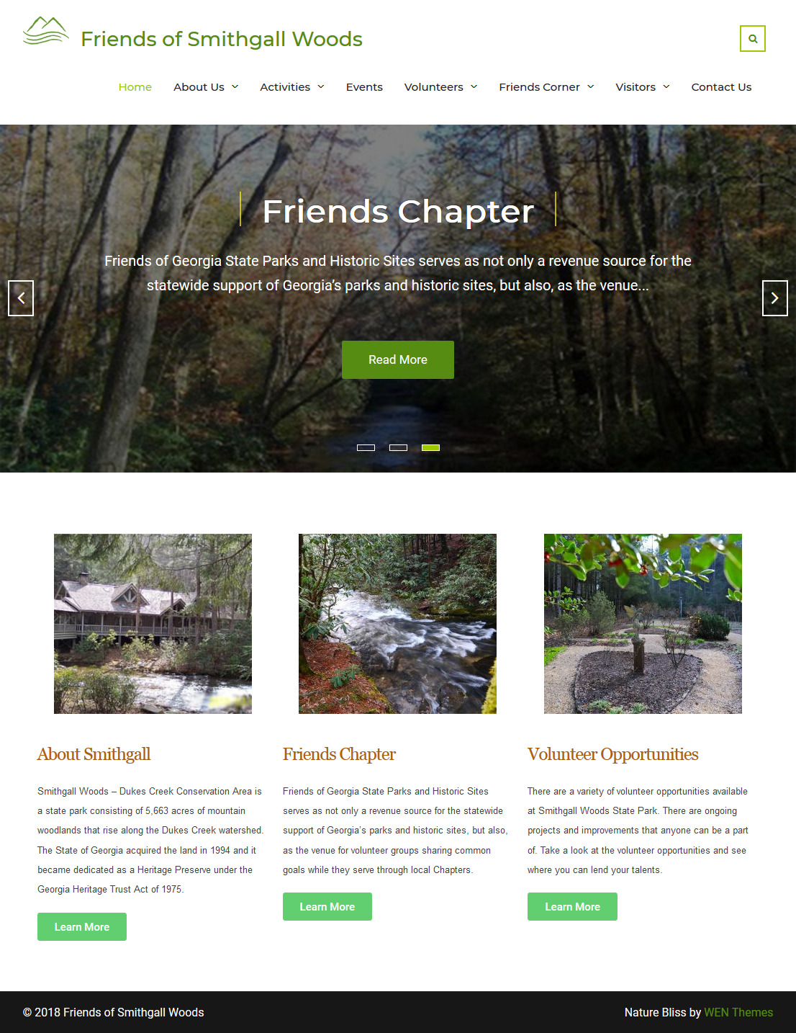
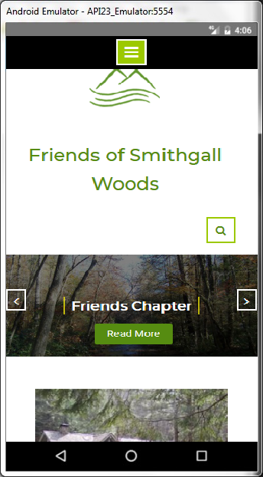
Desktop & Mobile Views

Slide 5
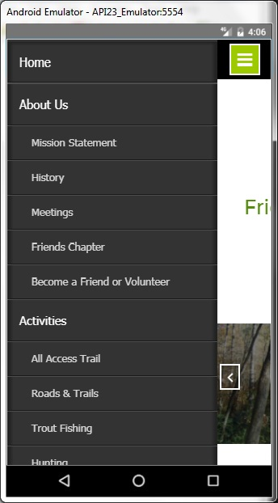
Responsive Design
Navigation Menu

Slide 6
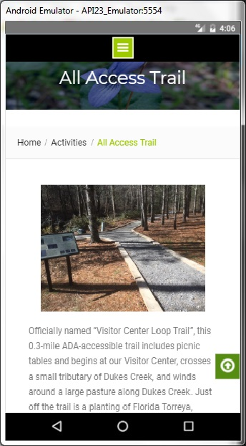
Responsive Design
All Access Trail (New Page)

Slide 7
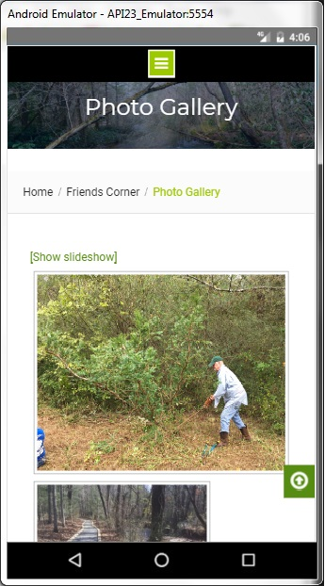
Responsive Design
Photo Gallery

Slide 8
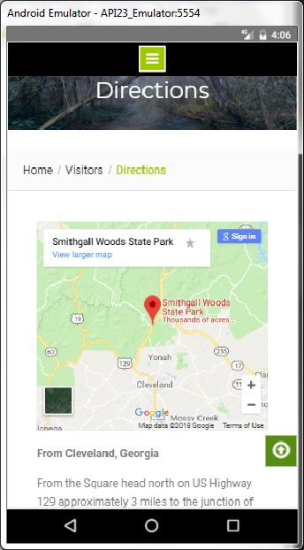
Responsive Design
Directions Page

Slide 9
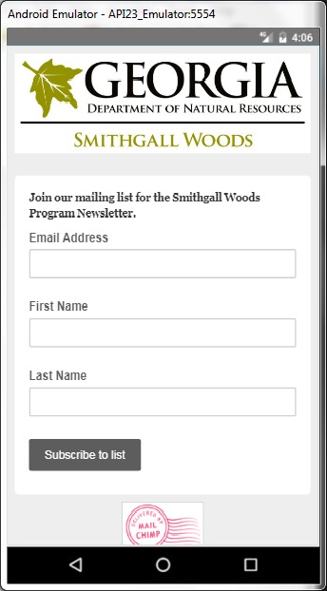
Responsive Design
Newsletter Sign-up (External Site)

Slide 10
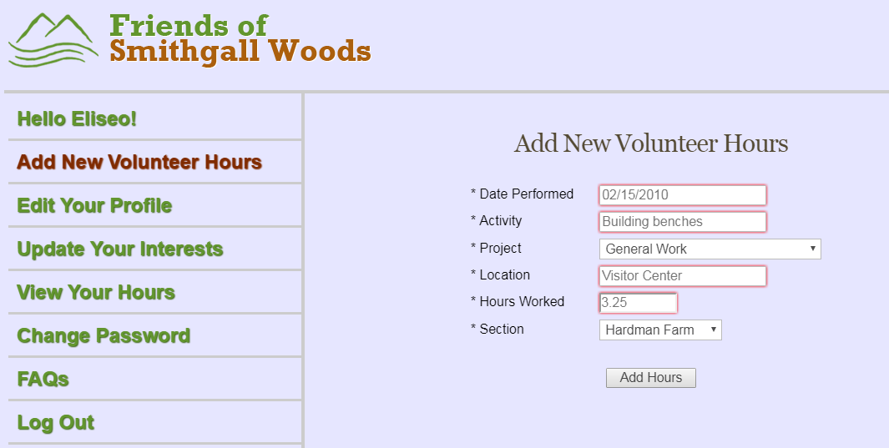
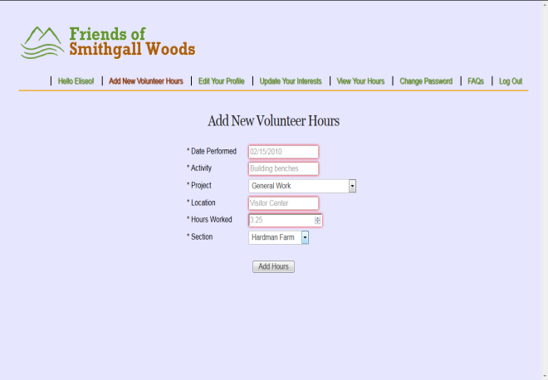
Improved Volunteer App
Added Login Name in navigation bar
Added Section Field for Hardman Farm & SGW
Updated app from PHP 5.6 to 7.2
Changed Top Menu Bar to Left Side-bar

Slide 11
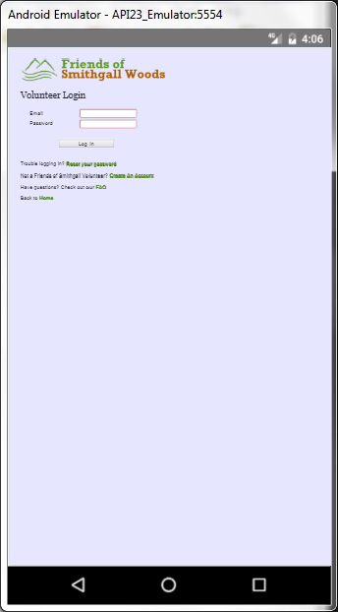
Mobile-friendly Design

Slide 12
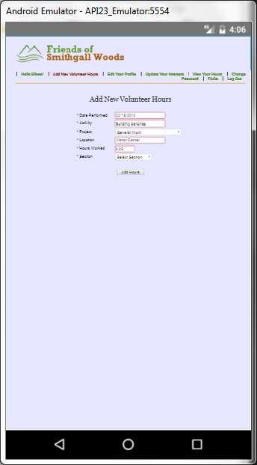
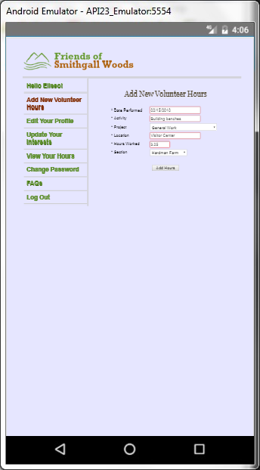
Mobile-friendly Design
Moved Top Menu Bar to Left Side-bar

Slide 13
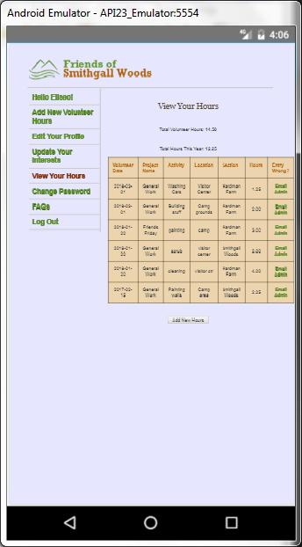
Mobile-friendly Design
View Hours

Slide 14
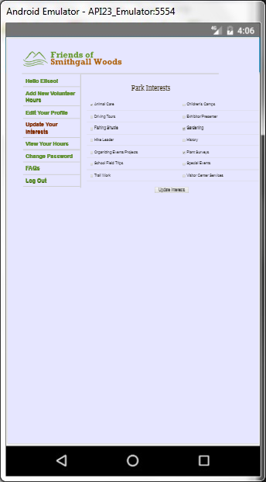
Mobile-friendly Design
Park Interests

Slide 15
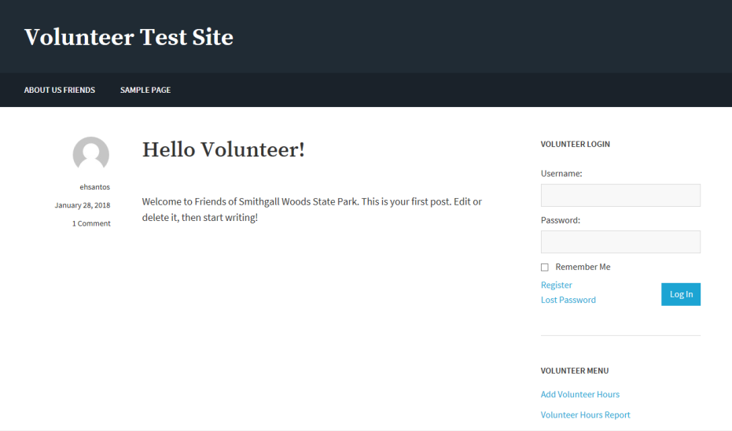
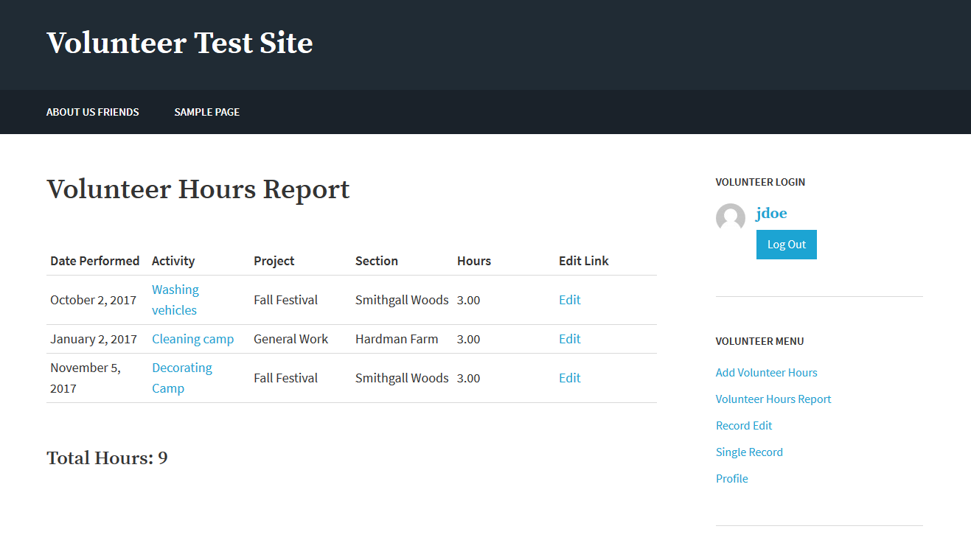
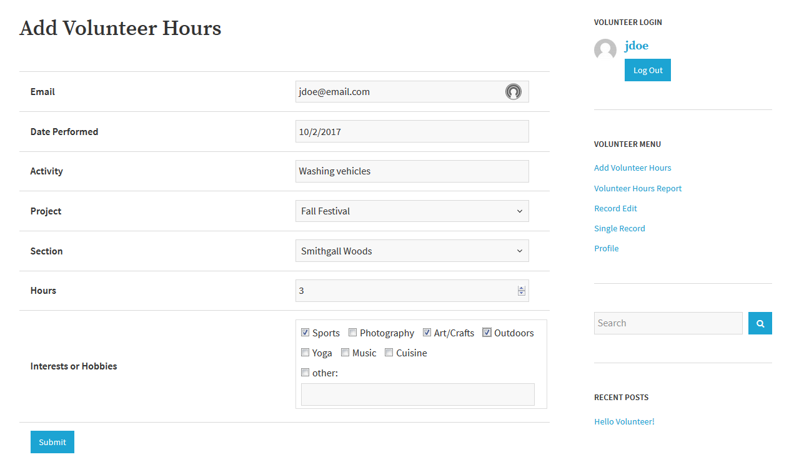
Volunteer App in WordPress
Alternate Solution using free plugins

Slide 16
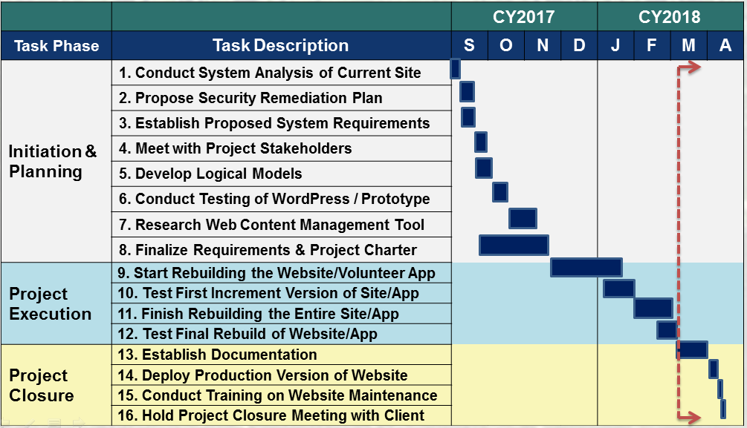
Project Schedule

Slide 17
Next Tasks….
Continue customizing site content with theme
Establish documentation for critical tasks
WP/Theme/Plugin Updates
Page Content Updates
Photo Gallery Updates
Events Page Updates
Develop video tutorials

Slide 18
Questions

Slide 19
BACKUPS

Slide 20
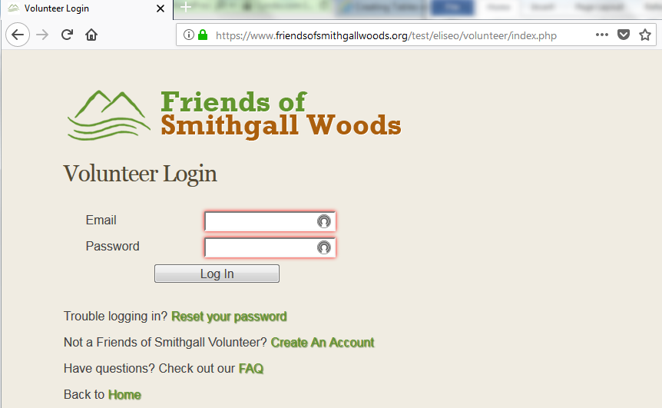
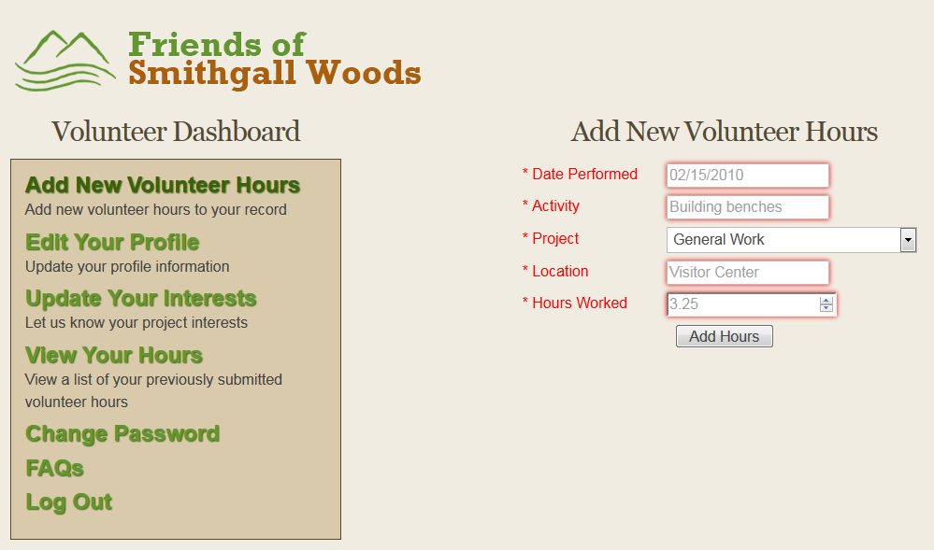
Existing Volunteer App
Stand-alone app linked from WP site

